Slide 1
Thesis Defense: Analysis of Various Algorithmic Approaches to Software-Based APRS Packet Demodulation
By: Robert Campbell
Committee Members: Dr. John Bellardo, Dr. Bridget Benson, and Dr. Dennis Derickson
Notes:
Introduce People in the room

Slide 2
What is APRS?
Automated Packet Reporting System.
A digital communication method used by hams.
Encoded into the Radio Using Bell 202
Notes:
Discuss Digital vs Analog Communication. Ironic note about how APRS is both.
Packet content can be many things but most commonly is a GPS position.
Mention that Bell 202 is the key to this research (not too much detail about what it is since that will be covered later)

Slide 3
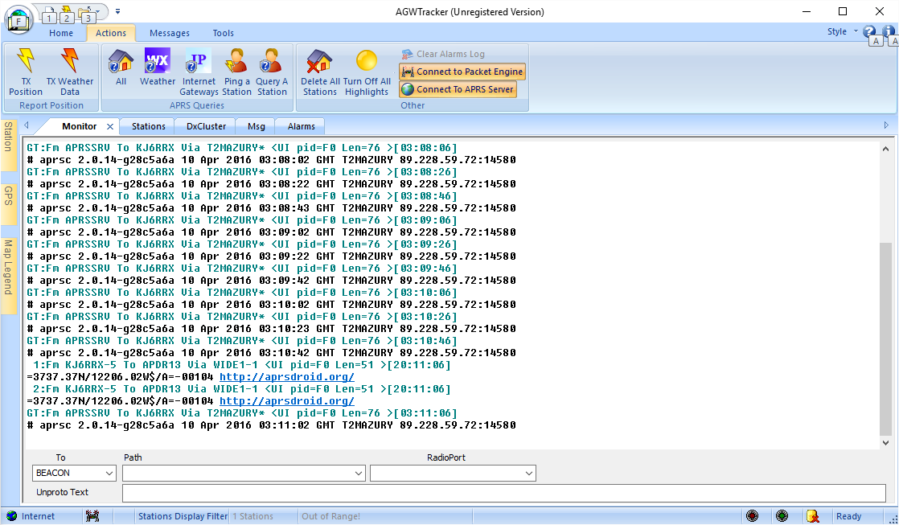
What does APRS look like?
Notes:
AGWTracker, AGWPE, Wildflower, course maps.

Slide 4
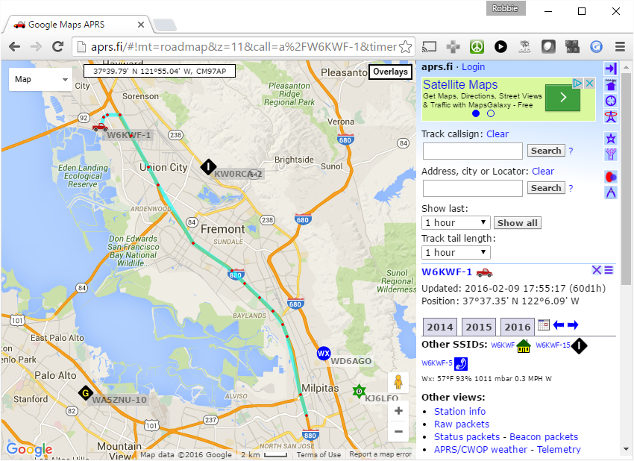
What does APRS look like?
Notes:
Walk through of APRS.fi show:
-Stations
-Tracks
-Messages
-Telemetry

Slide 5
Bell 202
1200 Baud AFSK using 1200Hz and 2200Hz tones.
Audio Frequency Shift Keying – using multiple tones in the audible range to encode data.

Slide 6
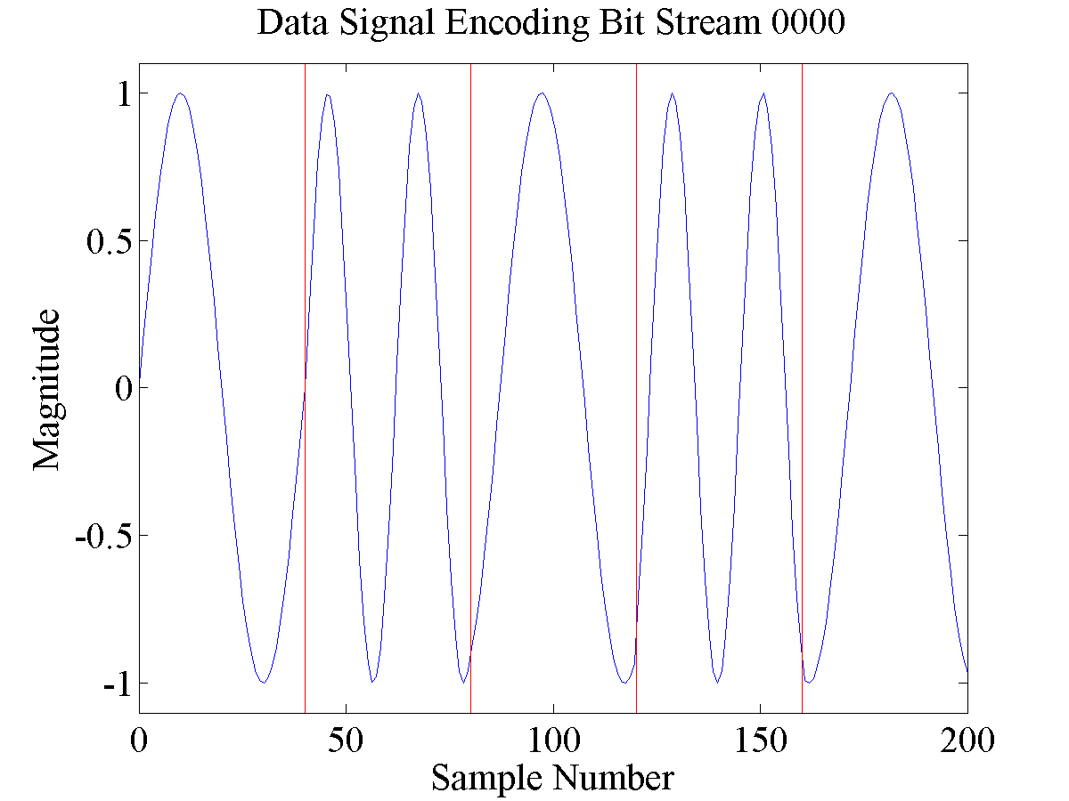
Example Signal
Notes:
1200Hz and 2200Hz tones.
Since 2200Hz doesn’t divide evenly in a 1200 baud bit period you can see that it changes the phase.

Slide 7

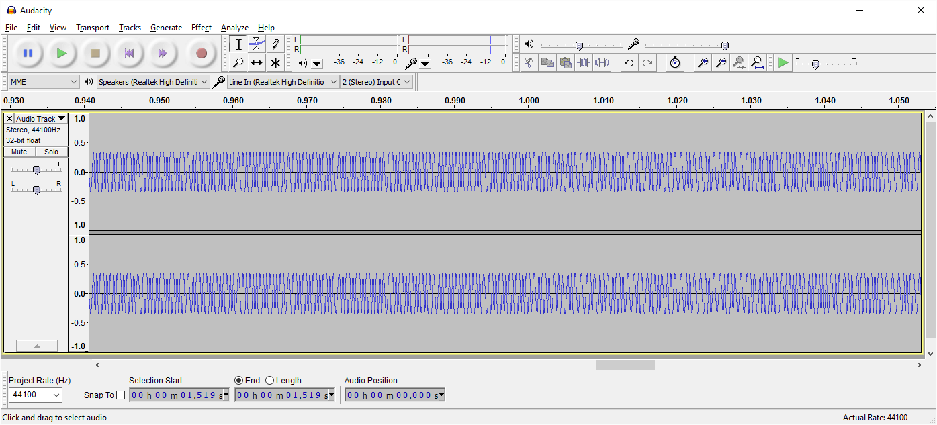
It’s in the audible range
What’s it sound like?
Notes:
Play Example APRS packet
Brief introduction to flags. Data is only contained in 0.5s worth of the audio file.

Slide 8
How to demodulate this signal?
Edge Detection
Correlation
Filters
Phase Locked Loop
Notes:
These approaches are shared in both hardware and software based approaches.

Slide 9
Edge Detection
Look for rising and falling edges
Distance between consecutive “zero-crossings” is λ/2

Slide 10
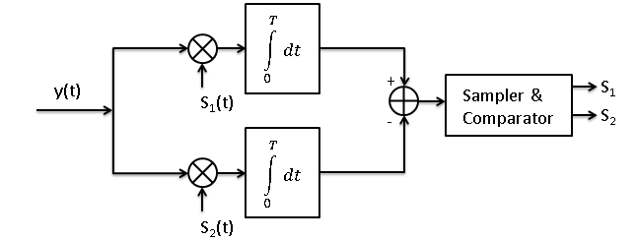
Correlation
Correlates original signal with expected signals.

Slide 11
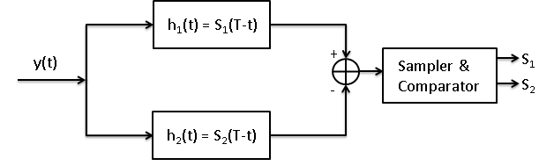
Filters
Filters look at signal strength of individual frequencies.

Slide 12
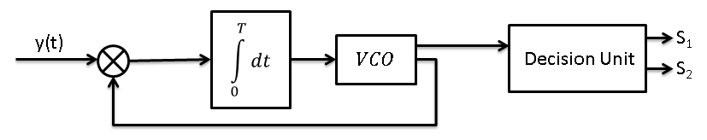
Phase Locked Loop (PLL)
Phase lock is acquired on the original signal.
As long as the VCO is locked the signal is known.

Slide 13
Approaches to Accessing the Network
Terminal Node Controllers
Specialty APRS Hardware
Radio Integrated
Software

Slide 14
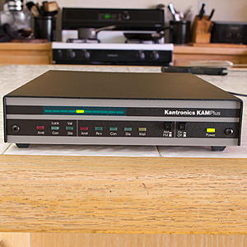
TNC Examples

Slide 15
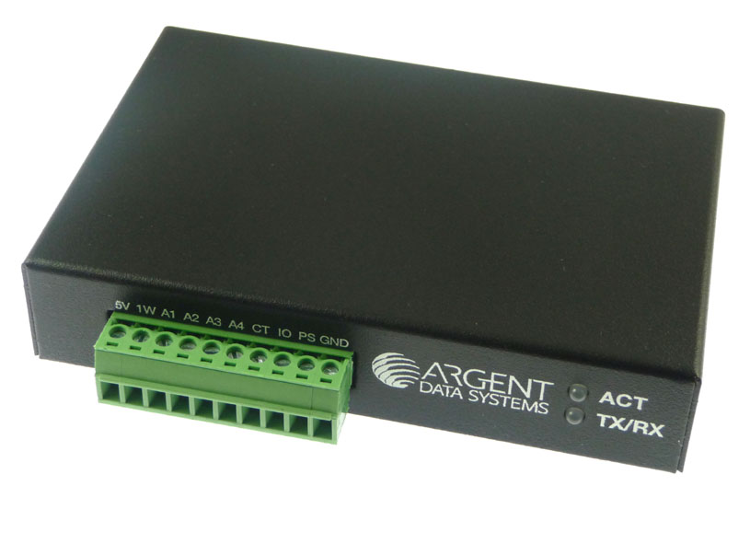
Argent Data Open Trackers

Slide 16
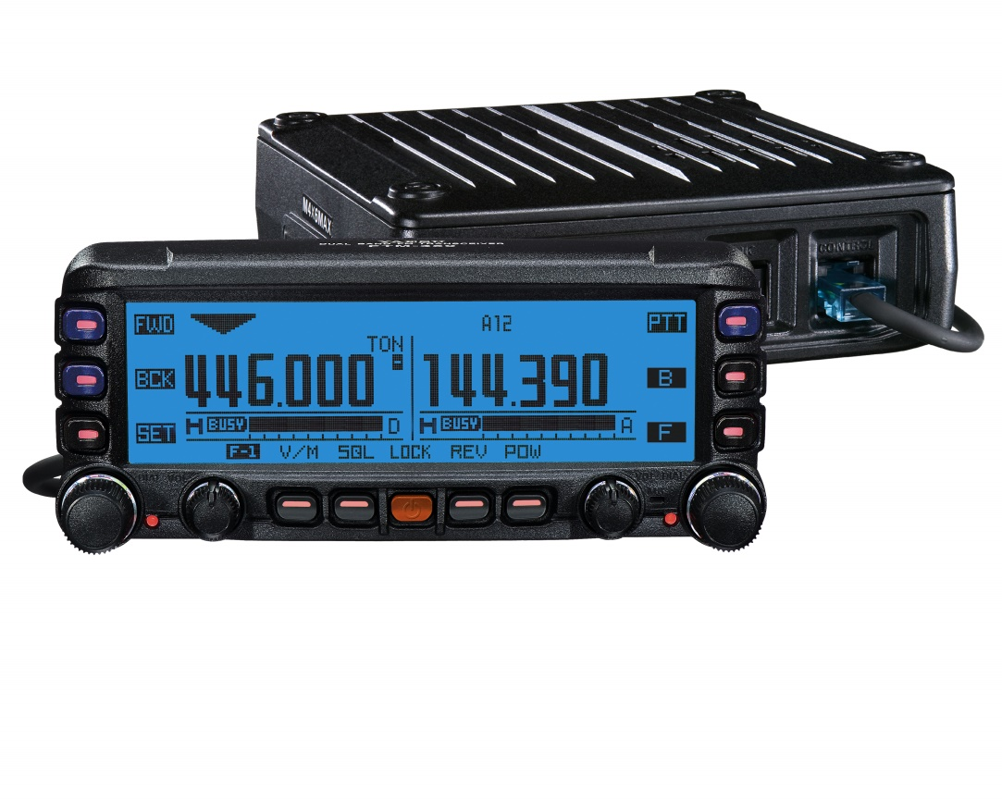
Radio Integrated APRS

Slide 17
AGWPE

Slide 18
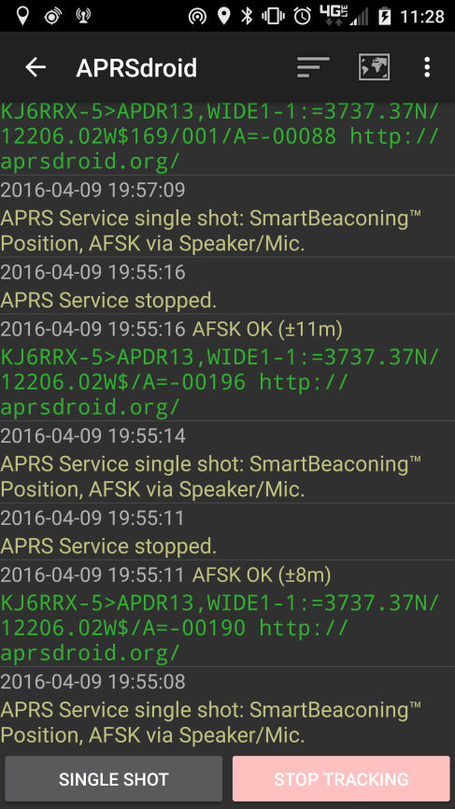
javAX25 in APRSdroid

Slide 19
Challenges
DC Offset
Noise
Emphasis

Slide 20
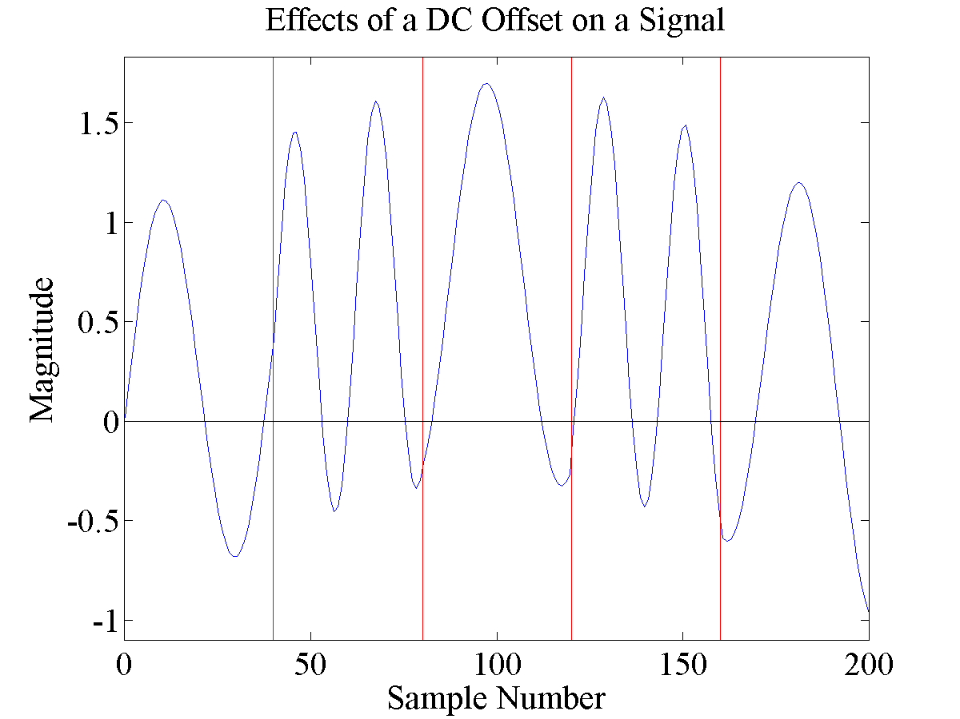
DC Offset

Slide 21
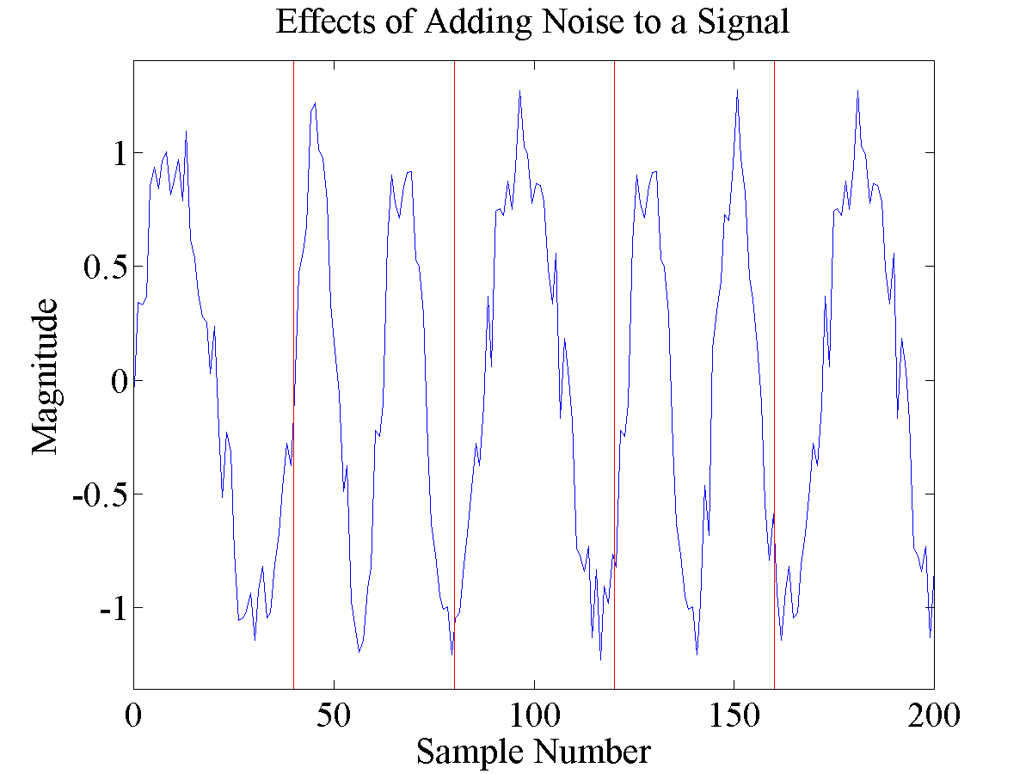
Noise

Slide 22
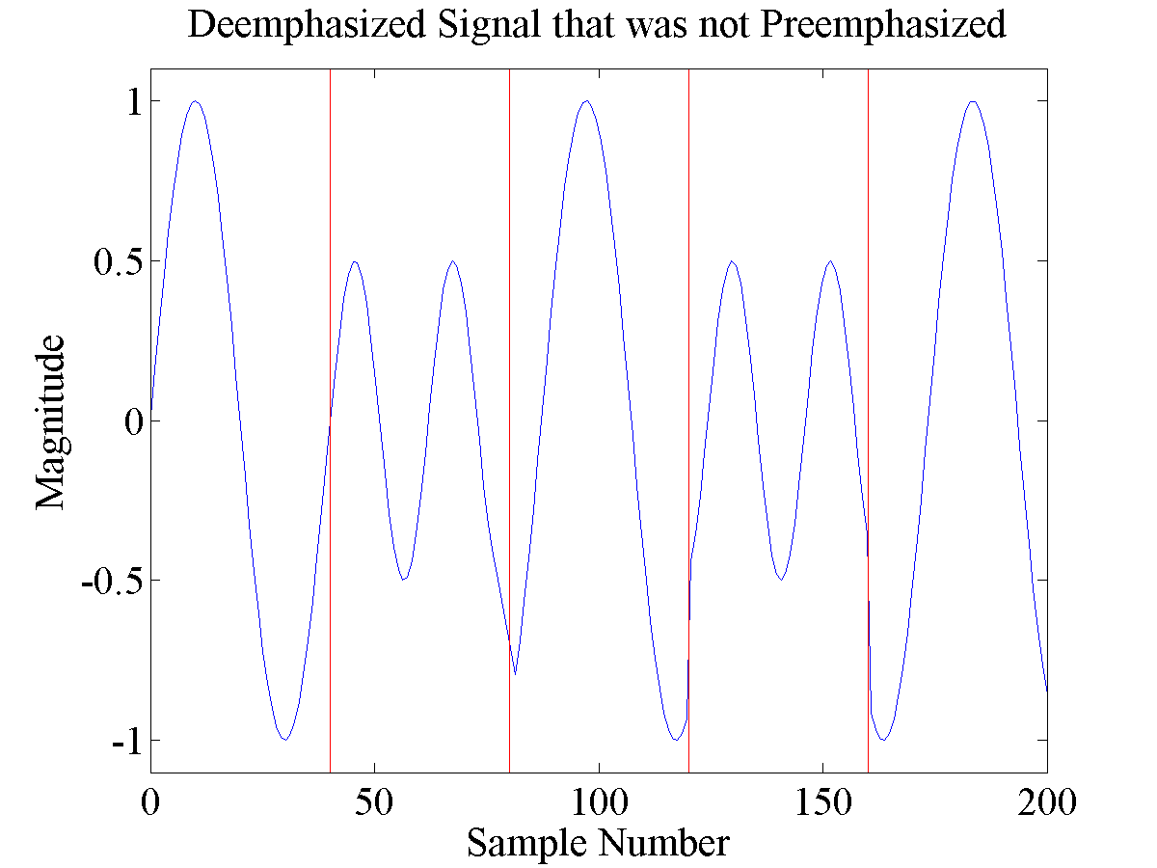
Emphasis

Slide 23
Algorithms Implemented
Zero Crossing
Goertzel (DFT / Filtering)
PLL
Preclocking

Slide 24
Zero Crossing

Slide 25
Goertzel (DFT / Filtering)

Slide 26
PLL

Slide 27
Preclocking

Slide 28
Benchmarking
OT3 Test
javAX25 Generated 200
OT3 Test + Ramping Noise
Track 1
Track 2

Slide 29
Clean Signal Example

Slide 30
Noise Example

Slide 31
Track 1 Example

Slide 32
Hardware Results - Clean

Slide 33
Hardware Results - Noise

Slide 34
Hardware Results – Track 1

Slide 35
Software Results - Clean

Slide 36
Software Results - Noise

Slide 37
Software Results – Track 1

Slide 38
Hardware versus Software

Slide 39
Ideas for Future Work

Slide 40
Conclusion

